Slide 1

PL/SQL Training

Slide 2
Objectives
At the end of the course, you should be to:
appreciate that PL/SQL provides programming extension to SQL
write PL/SQL code to interface with the Database
design PL/SQL units that executes efficiently

Slide 3
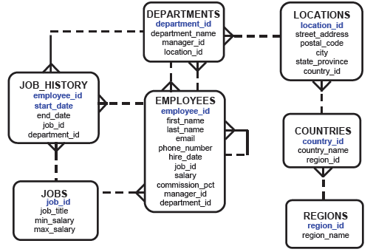
The Human Resources (HR) Schema That Is Used in This Course

Slide 4
What is PL/SQL?
Stands for Procedural Language extension to the Structured Query Language

Slide 5
Fundamentals of PL/SQL
It is highly structured, readable, and accessible language
It is a standard and portable language for Oracle development
It is an embedded language
It is a high-performance, highly integrated database language
Type in editor, execute in SQL*Plus

Slide 6
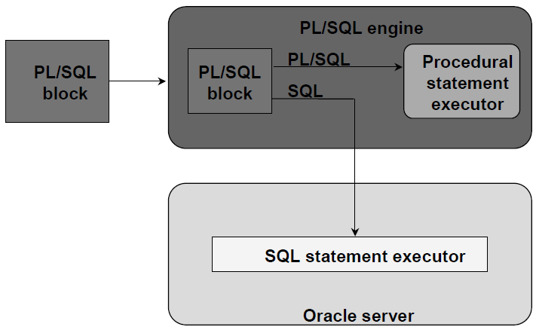
PL/SQL Environment

Slide 7
Benefits of PL/SQL
PL/SQL is portable
You can declare variables
You can program with procedure language control structures
PL/SQL can handle errors
Easy maintenance
Improved data security and integrity
Improved performance
Improved code clarity

Slide 8
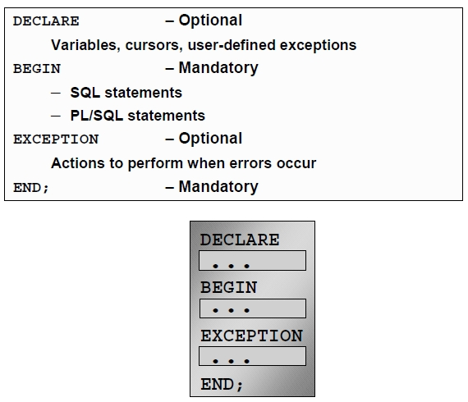
PL/SQL Block Structure

Slide 9
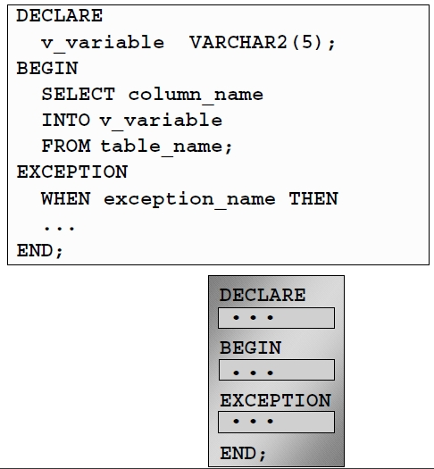
Example PL/SQL Blocks

Slide 10
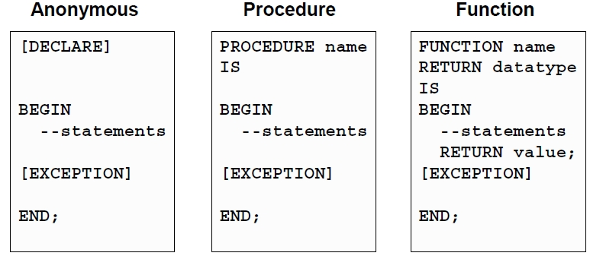
Blocks Types

Slide 11
Use of Variables
Variables can be used for:
Temporary storage of data
Manipulation of stored values
Reusability
Ease of maintenance

Slide 12
Handling Variables in PL/SQL
Declare and initialize variables in the declaration section
Assign new values to variables in the executable section
Pass values into PL/SQL blocks through parameters
View results through output variables

Slide 13
Types of Variables
PL/SQL variables:
Scalar
Composite
Reference
LOB (large objects)
Non-PL/SQL variables: Bind and host variables

Slide 14
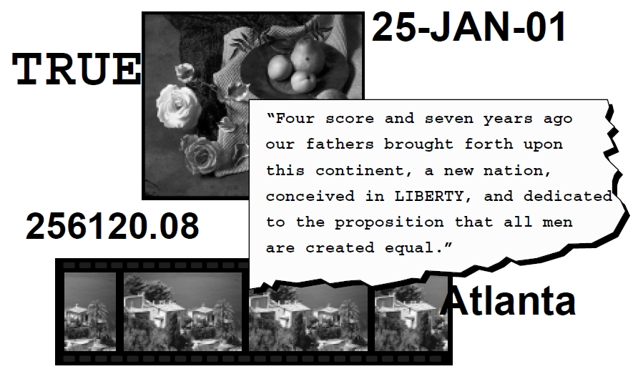
Types of Variables

Slide 15
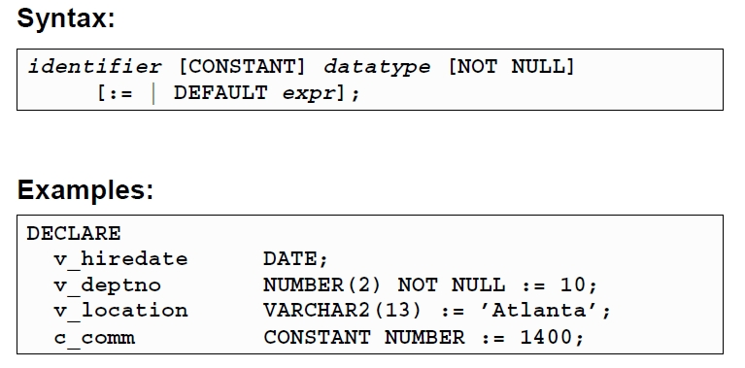
Declaring PL/SQL Variables

Slide 16
Guidelines for Declaring PL/SQL Variables
Follow naming conventions
Initialize variables designated as NOT NULL and CONSTANT
Declare one identifier per line
Initialize identifiers by using the assignment operation (:=) or the DEFAULT word
identifier := expr;

Slide 17
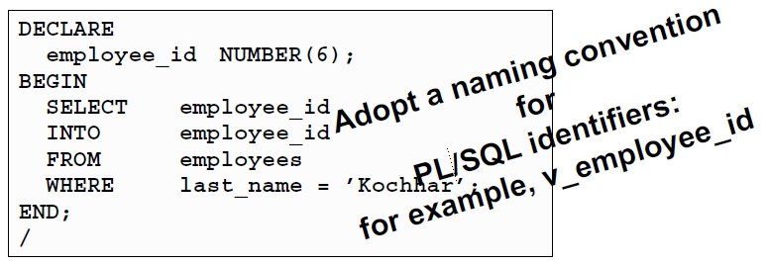
Naming Rules
Two variables can have the same name, provided they are in different block
The variable name (identifier) should not be the same as the name of table columns used in the block

Slide 18
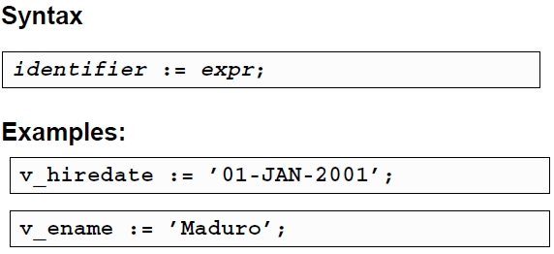
Variable Initialization and Keywords
Assignment operator (:=)
DEFAULT keyword
NOT NULL constraint

Slide 19
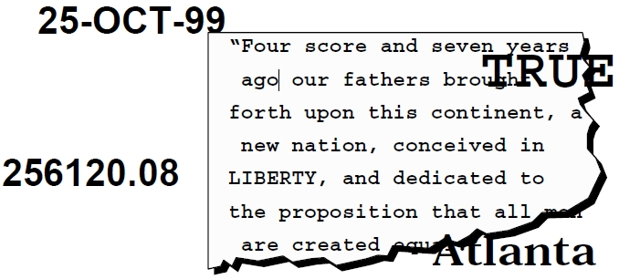
Scalar Data Types
Represent a single value
Have no internal components

Slide 20
Base Scalar Data Types
CHAR [ (maximum_length) ]
VARCHAR2 (maximum_length)
LONG
LONG RAW
NUMBER
BINARY_INTEGER
PLS_INTEGER
BOOLEAN
DATE
TIMESTAMP
TIMESTAMP WITH TIME ZONE
TIMESTAMP WITH LOCAL TIME ZONE
INTERVAL YEAR TO MONTH
INTERVAL DAY TO SECOND

Slide 21
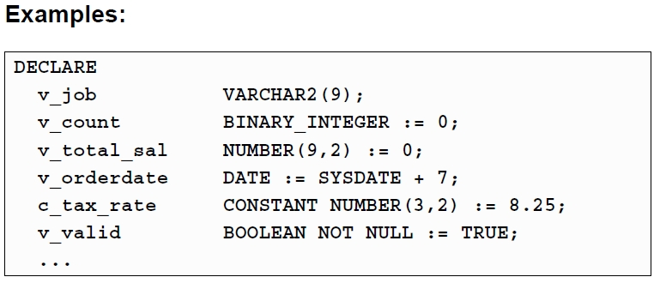
Scalar Variable Declarations

Slide 22
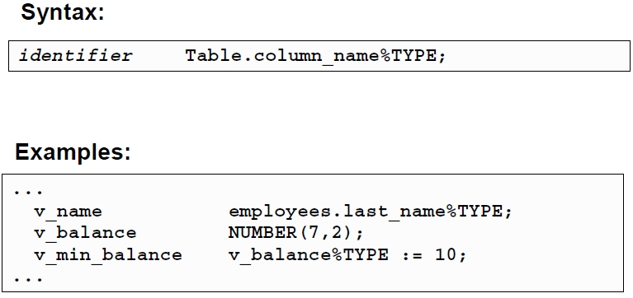
The %TYPE Attribute
Declare a variable according to:
A database column definition
Another previously declared variable
Prefix %TYPE with:
The database table and column
The previously declared variable name

Slide 23
Declaring Boolean Variables
Only the values TRUE, FALSE, and NULL can be assigned to a Boolean variable
The variables are compared by the logical operators AND, OR, and NOT
The variables always yield TRUE, FALSE, or NULL
Arithmetic, character, and date expressions can be used to return a Boolean value

Slide 24
Composite and Reference Variables
Composite variables
RECORD: contains multiple scalar values, similar to a table record
TABLE: tabular structure with multiple columns and rows
VARRAY: variable-sized array
Reference variables
Directly reference a specific database field or record and assume the data type of the associated field or record
%TYPE: same data type as a database field
%ROWTYPE: same data type as a database record

Slide 25
PL/SQL Block Syntax and Guidelines
Statements can continue over several lines
Lexical units can be classified as:
Delimiters
Identifiers
Literals
Comments

Slide 26
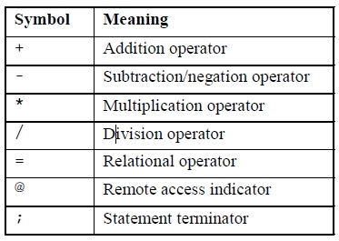
Simple Symbols

Slide 27
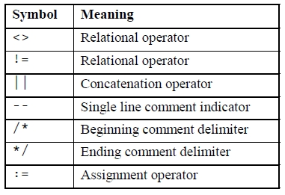
Compound Symbols

Slide 28
Identifiers
Can contain up to 30 characters
Must begin with an alphabetic character
Can contain numerals, dollar signs, underscores, and number signs
Cannot contain characters such as hyphens, slashes, and spaces
Should not have the same name as a database table column name
Should not be reserved words

Slide 29
PL/SQL Block Syntax and Guidelines
Literals
Character and date literals must be enclosed in single quotation marks
Example: v_name := ‘ROMMEL’;
Numbers can be simple values or scientific notation
A slash (/) runs the PL/SQL block in a script file or in some tools such as iSQL*PLUS

Slide 30
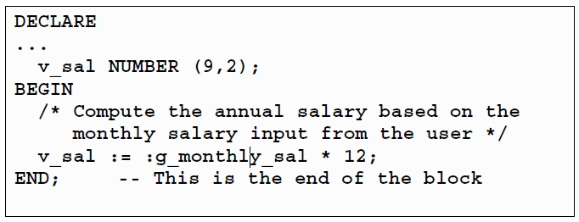
Commenting a Code
Prefix single-line comments with two dashes (--)
Place multiple-line comments between symbols /* and */
Example:

Slide 31
SQL Functions in PL/SQL
Available in procedural statements:
Single-row number
Single-row character
Data type conversion Same as in SQL
Date
Timestamp
GREATEST and LEAST
Miscellaneous functions
Not available in procedural statements:
DECODE
Group functions

Slide 32
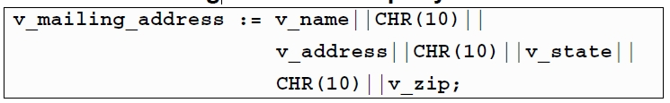
SQL Functions in PL/SQL: Examples
Build a mailing list for a company
Convert the employee name to lowercase

Slide 33
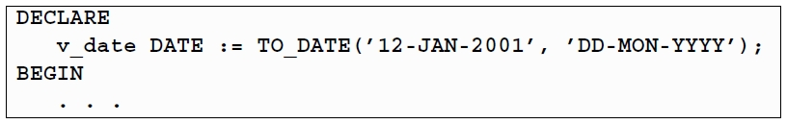
Data Type Conversion
Convert data to comparable data types
Mixed data types can result in an error and affect performance
Conversion functions:
TO_CHAR
TO_DATE
TO_NUMBER

Slide 34
Nested Blocks and Variable Scope
PL/SQL blocks can be nested wherever an executable statement is allowed
A nested block becomes a statement
An exception section can contain nested blocks
The scope of an identifier is that region of a program unit (block, subprogram, or package) from which you can reference the identifier

Slide 35
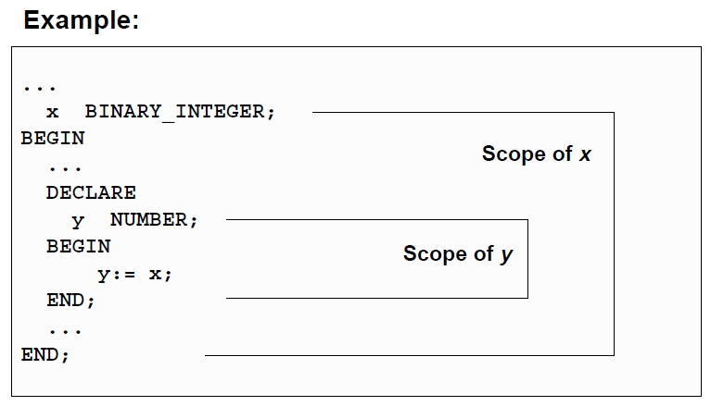
Nested Blocks and Variable Scope

Slide 36
Identifier Scope
An identifier is visible in the regions where you can reference the identifier without having to qualify it:
A block can look up to the enclosing block
A block cannot look down to the enclosed block

Slide 37
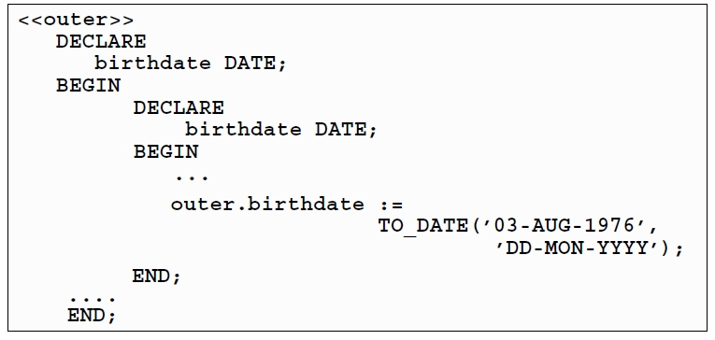
Qualify an Identifier
The qualifier can be the label of an enclosing block
Qualify an identifier by using the block label prefix

Slide 38
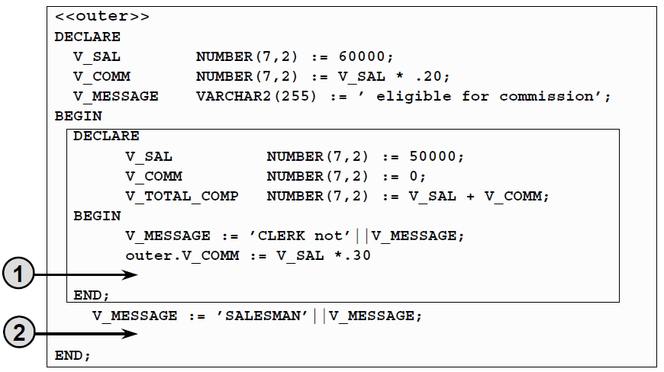
Determining Variable Scope
Exercise

Slide 39
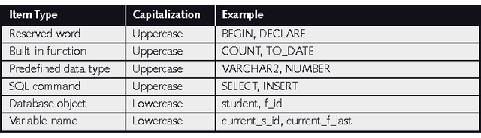
PL/SQL Command Capitalization Styles

Slide 40
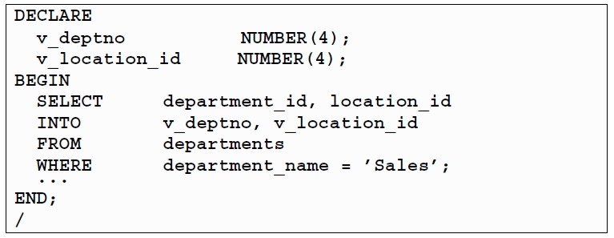
SELECT Statements in PL/SQL
The INTO clause is required
Queries must return one and only one row
Example:

Slide 41
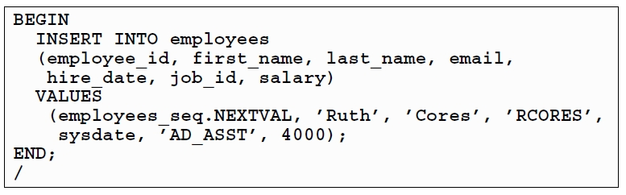
Inserting Data
Example:

Slide 42
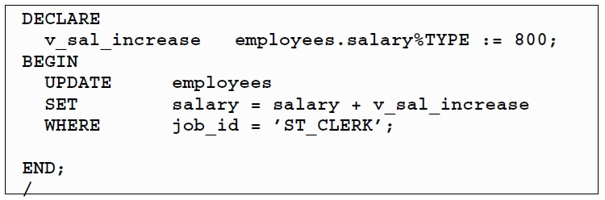
Updating Data
Example:

Slide 43
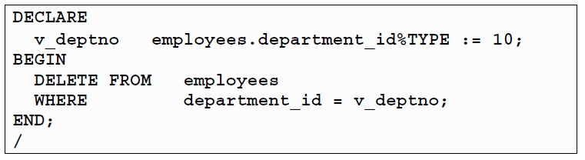
Deleting Data
Example

Slide 44
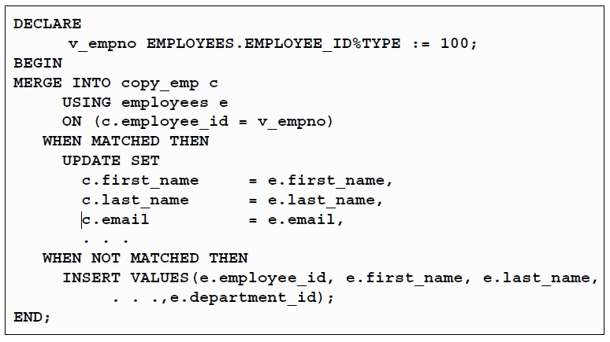
Merging Rows
Example:

Slide 45
SQL Cursor
A cursor is a private SQL work area
There are two types of cursors:
Implicit
Explicit
The Oracle server uses implicit cursors to parse and execute SQL statements
Explicit cursors are explicitly declared by the programmer

Slide 46
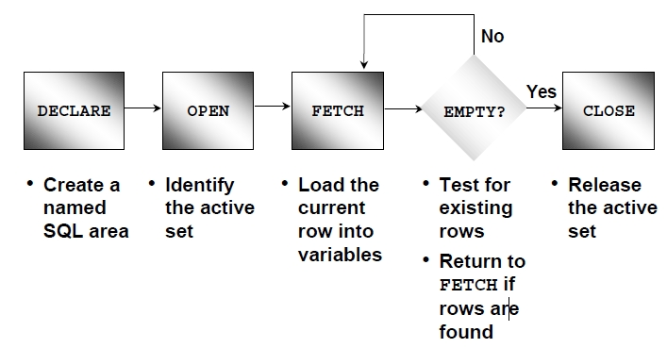
Controlling Explicit Cursors

Slide 47
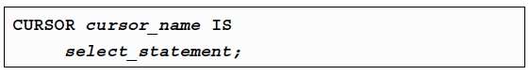
Declaring Cursors
Syntax:
Do not include the INTO clause in the cursor declaration
If processing rows in a specific sequence is required, use the ORDER BY clause in the query

Slide 48
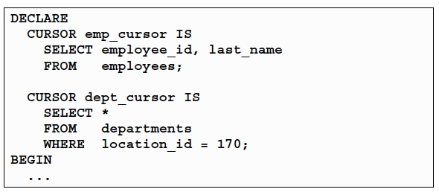
Declaring the Cursor
Example:

Slide 49
Opening the Cursor
Syntax:
Open the cursor to execute the query and identify the active set
If the query returns no rows, no exception is raised
Use cursor attributes to test the outcome after a fetch

Slide 50
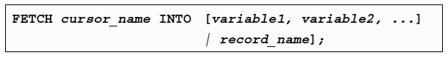
Fetching Data from the Cursor
Syntax:
Retrieve the current row values into variables
Include the same number of variables
Match each variable to correspond to the column’s position
Test to see whether the cursor contains row

Slide 51
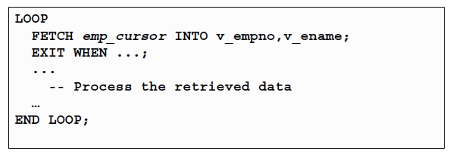
Fetching Data from the Cursor
Example:

Slide 52
Closing the Cursor
Syntax:
Close the cursor after completing the processing of the rows
Reopen the cursor, if required
Do not attempt to fetch data from a cursor after it has been closed

Slide 53
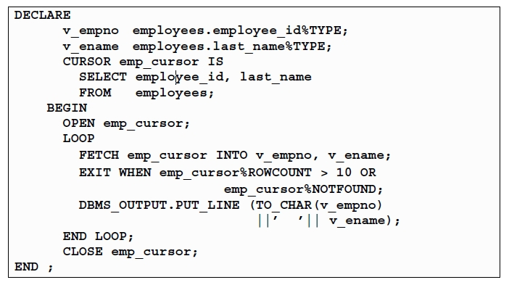
Cursor: Example

Slide 54
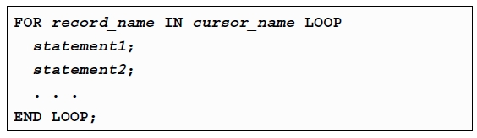
Cursor FOR Loops
Syntax:
The cursor FOR loop is a shortcut to process explicit cursors
Implicit open, fetch, exit, and close cursor
The record is implicitly declared

Slide 55
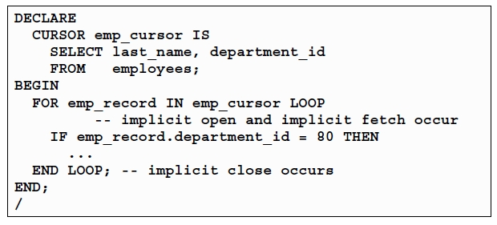
Cursor FOR Loops: Example

Slide 56
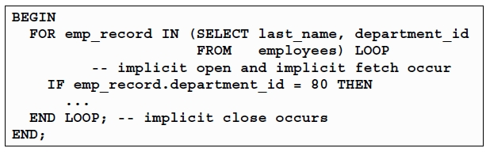
Cursor FOR Loops Using Subqueries
No need to declare the cursor
Example:

Slide 57
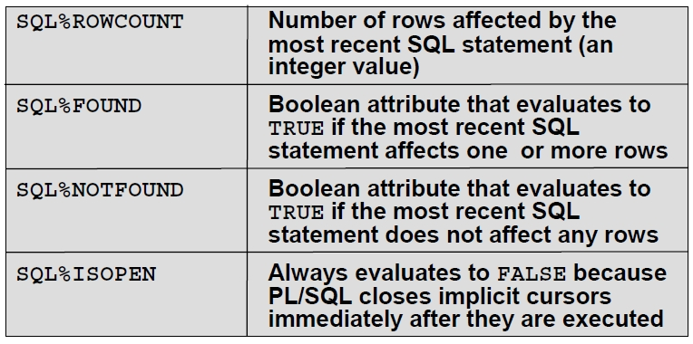
SQL Cursor Attributes
Using SQL cursor attributes, you can test the outcome of your SQL statements

Slide 58
Transaction Control Statements
Initiate a transaction with the first DML command to follow a COMMIT or ROLLBACK
Use COMMIT and ROLLBACK SQL statements to terminate a transaction explicitly

Slide 59

Controlling PL/SQL Flow of Execution
You can change the logical execution of statements using conditional IF statements and loop control structures
Conditional IF statements
IF-THEN-END IF
IF-THEN-ELSE-END IF
IF-THEN-ELSIF-END IF

Slide 60
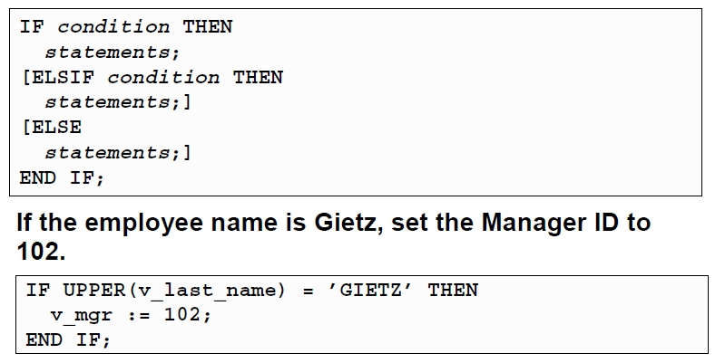
IF Statements
Syntax:
Example:

Slide 61
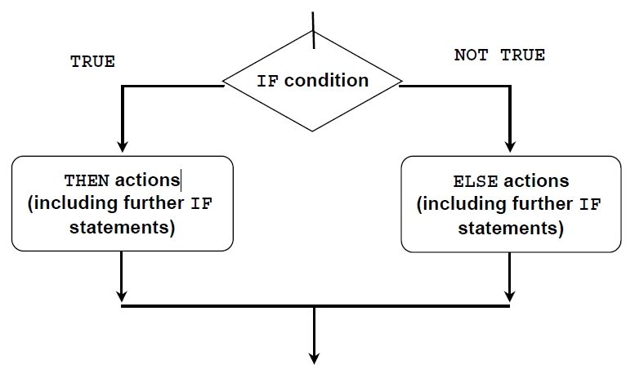
IF-THEN-ELSE Statement Execution Flow

Slide 62
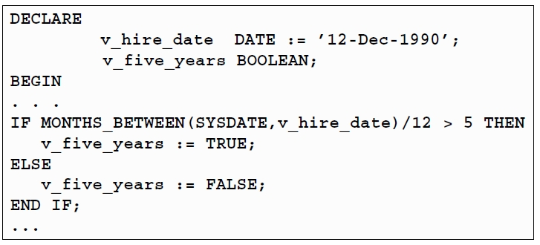
IF-THEN-ELSE Statements
Example:

Slide 63
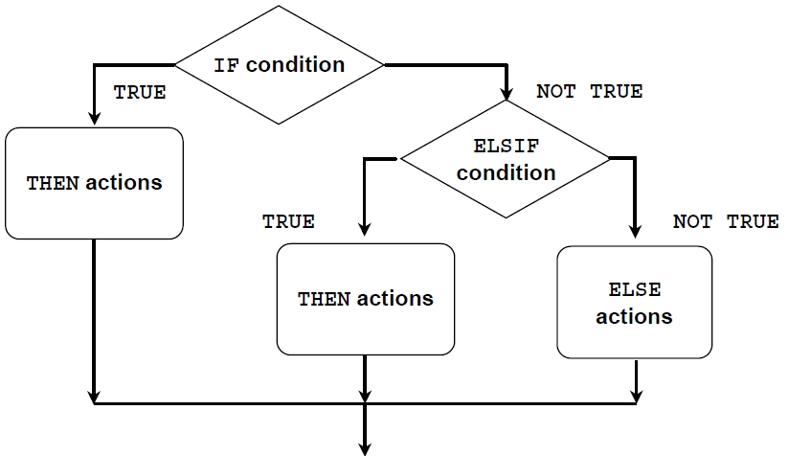
IF-THEN-ELSIF Statement Execution Flow

Slide 64
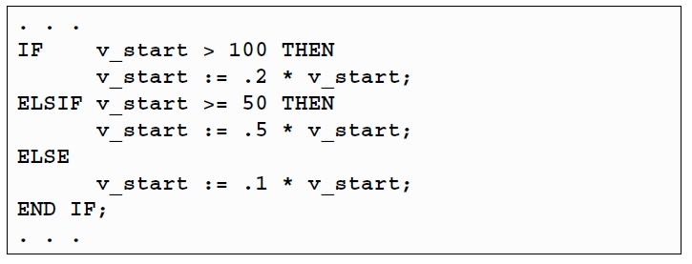
IF-THEN-ELSIF Statements
Example:

Slide 65
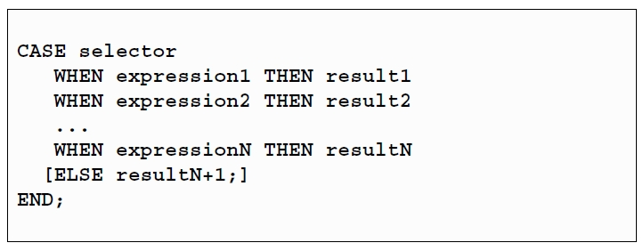
CASE Expressions
A CASE expression selects a result and returns it
To select the result, the CASE expression uses an expression whose value is used to select one of the several alternatives

Slide 66
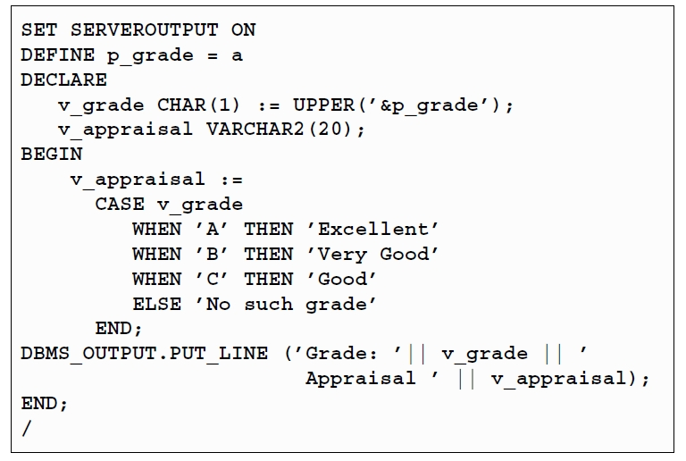
CASE Expressions: Example

Slide 67
Handling Nulls
When working with nulls, you can avoid some common mistakes by keeping in mind the following rules:
Simple comparisons involving nulls always yield NULL
Applying the logical operator NOT to a null yields NULL
In conditional control statements, if the condition yields NULL, its associated sequence of statements is not executed

Slide 68
Iterative Control: LOOP Statements
Loops repeat a statement or sequence of statements multiple times
There are three loop types:
Basic loop
FOR loop
WHILE loop

Slide 69
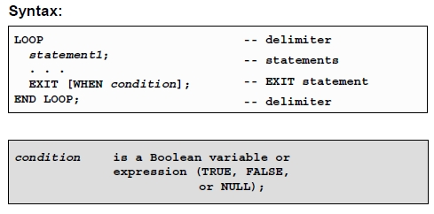
Basic Loops

Slide 70
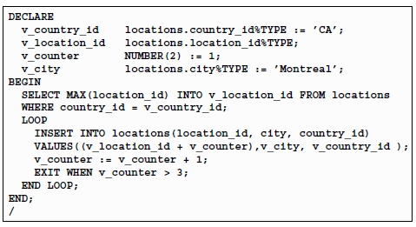
Basic Loops
Example

Slide 71
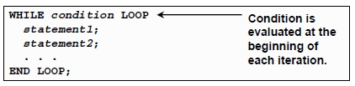
WHILE Loops
Syntax
Use the WHILE loop to repeat statements while a condition is TRUE

Slide 72
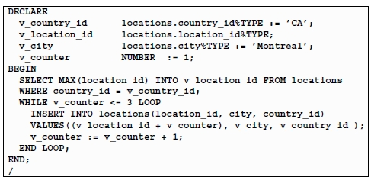
WHILE Loops
Example:

Slide 73
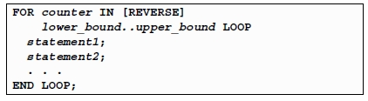
FOR Loops
Syntax:
Use a FOR loop to shortcut the test for the number of iterations
Do not declare the counter; it is declared implicitly
“lower_bound .. upper_bound” is required syntax

Slide 74
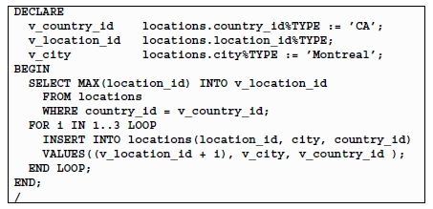
FOR LOOPS
Example:

Slide 75
FOR Loops: Guidelines
Reference the counter within the loop only; it is undefined outside the loop
Do not reference the counter as the target of an assignment
Use the basic loop when the statements inside the loop must execute at least once
Use the WHILE loop if the condition has to be evaluated at the start of each iteration
Use a FOR loop if the number of iterations is known

Slide 76
Handling Exceptions with PL/SQL
An exception is an identifier in PL/SQL that is raised during execution
How is it raised?
An Oracle error occurred
You raised it explicitly
How do you handle it?
Trap it with a handler
Propagate it to the calling environment

Slide 77
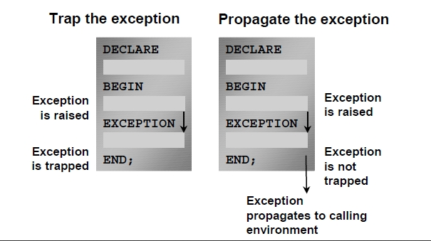
Handling Exceptions

Slide 78

Exception Types
Implicitly raised
Explicitly raised

Slide 79

Trapping Exceptions
Syntax:

Slide 80
Trapping Exceptions Guidelines
The EXCEPTION keyword starts exception-handling section
Several exception handlers are allowed
Only one handler is processed before leaving the block
WHEN OTHERS is the last clause

Slide 81
Trapping Predefined Oracle Server Errors
Reference the standard name in the exception-handling routine
Sample predefined exceptions:
NO_DATA_FOUND
TOO_MANY_ROWS
INVALID_CURSOR
ZERO_DIVIDE
DUP_VAL_ON_INDEX

Slide 82

Trapping User-Defined Exceptions

Slide 83

User-Defined Exceptions: Example

Slide 84
Overview of Subprograms
A subprogram:
Is a named PL/SQL block that can accept parameters and be invoked from a calling environment
Is of two types:
A procedure that performs an action
A function that computes a value
Is based on standard PL/SQL block structure
Provides modularity, reusability, extensibility, and maintainability
Provides easy maintenance, improved data security and integrity, improved performance, and improved code clarity

Slide 85


Anonymous vs Subprogram Blocks

Slide 86
What is a Procedure?
A procedure is a type of subprogram that performs an action
A procedure can be stored in the database, as a schema object, for repeated execution

Slide 87

Syntax for Creating Procedures
The REPLACE option indicates that if the procedure exists, it will be dropped and replaced with the new version created by the statement
PL/SQL block starts with either BEGIN or the declaration of local variables and ends with either END or END procedure_name

Slide 88
Formal Versus Actual Parameters
Formal parameters: variables declared in the parameter list of a subprogram specification
Example:
CREATE PROCEDURE raise_sal (p_id NUMBER, p_amount NUMBER)
…
END raise_sal;
Actual parameters: variables or expressions referenced in the parameter list of a subprogram call
Example:
Raise_sal(v_id, 2000);

Slide 89

Procedural Parameter Modes

Slide 90

Creating Procedures with Parameters

Slide 91

IN Parameters: Example

Slide 92


OUT Parameters: Example

Slide 93

Viewing OUT Parameters

Slide 94

IN OUT Parameters

Slide 95

Viewing IN OUT Parameters

Slide 96
Methods for Passing Parameters
Positional: List actual parameters in the same order as formal parameters
Named: List actual parameters in arbitrary order by associating each with its corresponding formal parameter
Combination: List some of the actual parameters as positional and some as named

Slide 97

DEFAULT Option for Parameters

Slide 98

Examples for Passing Parameters

Slide 99

Declaring Subprograms

Slide 100

Invoking a Procedure from an Anonymous PL/SQL Block

Slide 101

Invoking a Procedure from Another Procedure

Slide 102

Handled Exceptions

Slide 103

Handled Exceptions

Slide 104

Unhandled Exceptions

Slide 105

Creating Functions
Overview of Stored Functions
A function is named PL/SQL block that returns a value
A function can be stored in the database as an schema object for repeated execution
A function is called as part of an expression
Syntax:
The PL/SQL block must have at least one return statement

Slide 106

Creating Functions
Enter the text of the CREATE FUNCTION statement in an editor and save it as a SQL script file
Run the script file to store the source code and compile the function
Use SHOW ERRORS to see compilation errors
When successfully compiled, invoke the function

Slide 107

Executing Functions
Invoke a function as part of the PL/SQL expression
Create a variable to hold returned value
Execute the function. The variable will be populated by the value returned through a RETURN statement
Example:

Slide 108
Advantages of User-Defined Functions in SQL Expressions
Extend SQL where activities are too complex, too awkward, or unavailable with SQL
Can increase efficiency when used in the WHERE clause to filter data, as opposed to filtering the data in the application
Can manipulate character string

Slide 109

Invoking Functions in SQL Expressions: Example

Slide 110
Locations to Call User-Defined Functions
Select list of a SELECT command
Conditions of the WHERE and HAVING clauses
CONNECT BY, START WITH, ORDER BY, and GROUP BY clauses
VALUES clause of the INSERT command
SET clause of the UPDATE command

Slide 111
Restrictions on Calling Functions from SQL Expressions
To be callable from SQL expressions, a user-defined function must:
Be stored function
Accept only IN parameters
Accept only valid SQL data types, not PL/SQL specific types as parameters
Return data types that are valid SQL data types, not PL/SQL specific types
Functions called from SQL expressions cannot contain DML statements
Functions called from UPDATE/DELETE statements on a table T cannot contain DML on the same table T
Functions called from a DML statement on a table T cannot query the same table
Functions called from the SQL statements cannot contain statements that end the transactions
Calls to subprograms that breaks the previous restriction are not allowed in the function

Slide 112

Procedure or Function?

Slide 113

Comparing Procedures and Functions

Slide 114
Creating Packages
Overview of Packages
Packages:
Group logically related PL/SQL types, items, and subprograms
Consists of two parts:
Specification
Body
Cannot be invoked, parameterized, or nested
Allow the Oracle server to read multiple objects into memory at once

Slide 115

Components of a Package

Slide 116

Referencing Package Objects

Slide 117
Developing a Package
Saving the text of the CREATE PACKAGE statement in two different SQL files facilitates later modifications to the package
A package specification can exist without a package body, but a package body cannot exist without a package specification

Slide 118

Creating the Package Specification
Syntax:
The REPLACE option drops and recreates the package specification
Variables declared in the package specification are initialized to NULL by default
All the constructs declared in the package specification are visible to users who are granted privileges on the package

Slide 119

Declaring Public Constructs

Slide 120

Creating the Package Body
Syntax:
The REPLACE option drops and recreates the package body
Identifiers defined only in the package body are private constructs. These are not visible outside the package body
All private constructs must be declared before they are used in the public constructs

Slide 121

Public and Private Constructs

Slide 122

Creating a Package Body: Example

Slide 123

Invoking Package Constructs
Example 1: Invoke a function from a procedure with the same package

Slide 124

Invoking Package Constructs
Example 2: Invoke a package procedure from SQL Plus
Example 3: Invoke a package procedure in a different schema
Example 4: Invoke a package procedure in a remote database

Slide 125

Declaring a Bodiless Package

Slide 126

Referencing a Public Variable from a Stand-Alone Procedure
Example:

Slide 127
Guidelines for Developing Packages
Construct packages for general use
Define the package specification before the body
The package specification should contain only those constructs that you want to be public
Place items in the declaration part of the package body when you must maintain them throughout a session or across transactions
Changes to the package specification require recompilation of each referencing subprograms
The package specification should contain as few constructs as possible

Slide 128
Advantages of Packages
Modularity: Encapsulate related constructs
Easier application design: Code and compile specification and body separately
Hiding information:
Only the declarations in the package specifications are visible and accessible to applications
Private constructs in the package body are hidden and inaccessible
All coding is hidden in the package body

Slide 129
Advantages of Packages
Added functionality: Persistency of variables and cursors
Better performance:
The entire package is loaded into memory when the package is first referenced
There is only one copy in memory for all users
The dependency hierarchy is simplified
Overloading: Multiple subprograms of the same name

Slide 130
Overloading
Enables you to use the same name for different subprograms inside a PL/SQL block, a subprogram, or a package
Requires the formal parameters of the subprograms to differ in number, order, or data type family
Enables you to built more flexibility because a user or application is not restricted by the specific data type or number of formal parameters
Note: Only local or packaged subprograms can be overloaded, you cannot overload stand-alone subprograms

Slide 131

Overloading: Example

Slide 132

Overloading: Example

Slide 133
Revision History
Revision Date | Description | Revised By
February 7, 2011 | Created the training material | Rommel C. Oli

